Slide 1
“AI DRIVEN MATH ASSISTANT”
MOHAN BUDHA
DATE: OCT 7, 2024

Slide 2
OBJECTIVE
Build a chatbot to solve math problems using GPT-4.
Integrate graph plotting for mathematical functions.
Enable OCR for detecting math problems from images.

Slide 3
STATEMENT OF PROBLEM
Accurately solve mathematical problems, graph plotting, to assist users with queries.
Extract and solve mathematical problems from images
Provide reliable solutions for mathematical problems and is user-friendly

Slide 4
LITERATURE REVIEW
GPT-4 Technical Report
Authors:OpenAI( DOI: doi.org/10.48550/arXiv.2303.08774)
Main Idea: It introduces GPT-4, a large-scale multimodal model that processes both text
and image inputs to generate text outputs.And the report outlines the model's architecture,
training process, and evaluation results. Increase the model capabilities to to achieve
human-level performance And still faces challenges such as "hallucinations" (producing incorrect information) and limited context windows.
A Complete Survey on LLM-based AI Chatbots
Authors: Sumit Kumar Dam, Choong Seon Hong, Yu Qiao, Chaoning Zhang (DOI: 10.48550/arXiv.2406.16937)
Main Idea: IT presents a complete survey of the evolution and deployment of LLM-based chatbots in various sectors examining their applications, challenges, and future directions to enhance efficiency and reliability.And compares each LLMS of different phases.
MATHCHAT: Converse to Tackle Challenging Math Problems with LLM Agents
Authors: Yiran Wu, Feiran Jia, Shaokun Zhang, Hangyu Li, Erkang Zhu, Yue Wang, Yin Tat Lee, Richard Peng, Qingyun Wu, Chi Wang
Main Idea: The paper introduces MathChat, a conversational framework that uses Large Language Models (LLMs) to collaboratively solve challenging mathematical problems. It combines an LLM agent and a user proxy agent to enhance problem-solving capabilities through dialogue

Slide 5
ABOUT DATASETS
OPEN AI :
Used the open ai Gpt-4 model: a pre-trained dataset effectively increase the accuracy and functionality of my maths bot.
OCR Integrations:
Integrated Tesseract, a pre-trained OCR library, to extract mathematical problems from images.
No-Custom datasets:
Open AI API supports all fine-tuned data for my bot and To maintain time constraint, didn’t use custom datasets.

Slide 6
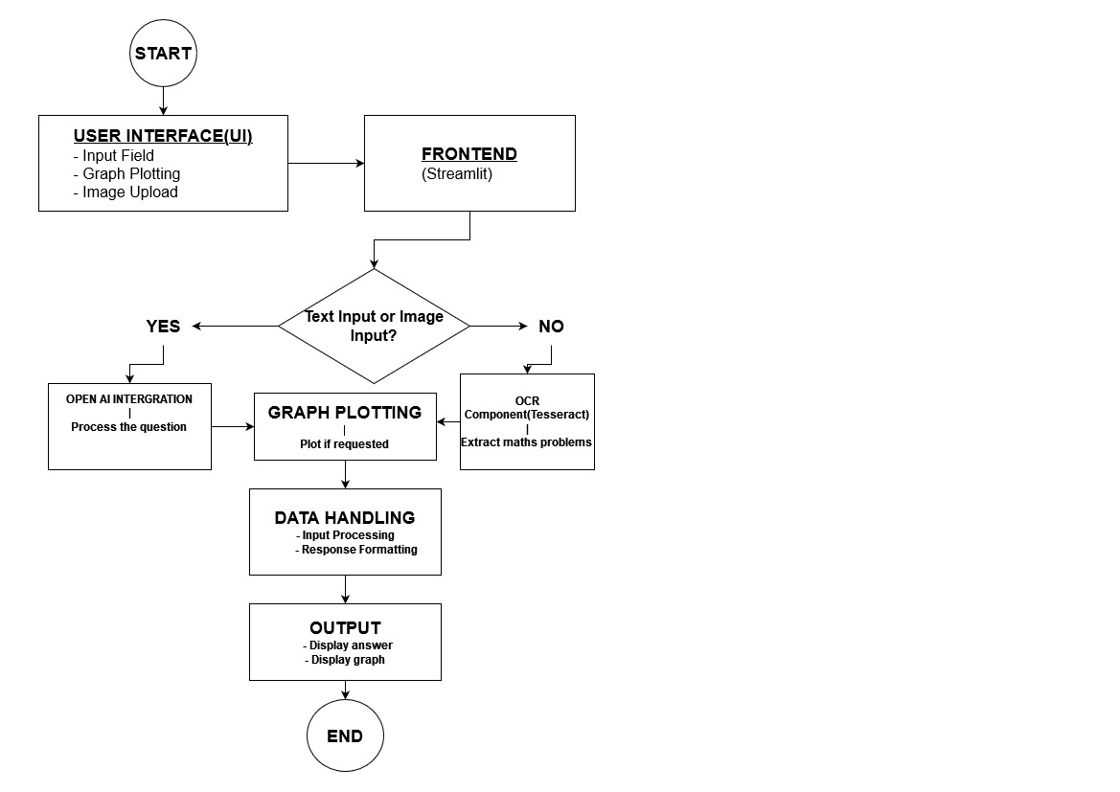
.
STRUCTURAL DIAGRAM

Slide 7
CORE AI COMPONENT ARCHITECTURE
1. OpenAI GPT-4 Model
Purpose: Facilitates the chatbot capability to solve mathematical problems.
Key Features:
Effectively solve text based problems
Efficiency and accurate in solving math problems.
2. OCR (Tesseract)
Purpose: Allows the chatbot to extract mathematical problems from user-provided images.
Key Features:
Text Extraction: extract contents from the images.
Effective Integration: effectively works with the GPT-4 model to respond to queries.

Slide 8
TRAINING SETTINGS AND LEARNING CURVES
Training Settings: We use OpenAI’s pre-trained GPT-4 model, so training details like hyperparameters and loss functions are not accessible.
Learning Curves: Since the model GPT-4 is pre-trained, I cannot provide learning curves for training or validation.

Slide 9
MODEL EVALUATION
Problem-Solving Accuracy:
Quick and easy solutions to problems
Versatility:
Graph plotting
OCR
Range of Problems:
Numerical problems, word problems
User Experience:
Easy interface
Solutions to problems
PROBLEMS:
Cannot solve case sensitive problems
problems in image recognition(Advance problems, hand written)
Fails if plot is not in the f(x) format

Slide 10
SYSTEM PERFORMANCE ASSESSMENT
Response Accuracy:High accuracy in solving math problems, including graph plotting and OCR recognition.
System Latency: Average response time is within a few seconds, suitable for real-time interaction.
Deployment: Deployed via Streamlit on cloud infrastructure, using OpenAI GPT-4 API.
Hardware: Standard CPU settings (e.g., Google Colab or Streamlit servers) are sufficient to run.
Inference:Computation for inference is handled by OpenAI servers.

Slide 11
SCOPES IN REAL WORLD
.
Academic Support
SCOPES
Data analysis and visualization: Supports graphs
Easy Accessibility: support text based and image based problems.
Diversity in use: academia, research etc.

Slide 12
KEY FEATURES
Problems Solving: Maths problems
Optical Character Recognition (OCR): extract text from image and solve problem
Graph plotting
User friendly interface:Used streamlit (free)
Support multiple input methods: Text and image

Slide 13
SYSTEM FAILURE CASES
List at max 3 failure cases of your system
If the Questions is not asked in formatted way(Case sensitive)
Don’t support advance images and hand written
Only support line graph so, fails if asked beyond(Trigonometric, linear functions, polynomial equations)
OCR Features: Only solves basic numerical maths

Slide 14
FUTURE ENHANCEMENT
Solve advance maths
Supports hand-written text in image and advance maths solutions
And self-learning.
Remove case sensitive

Slide 15
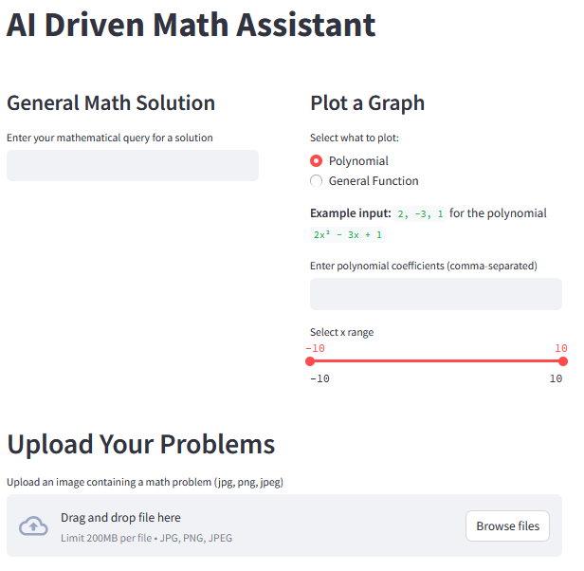
SCREENSHOT: Main interface

Slide 16
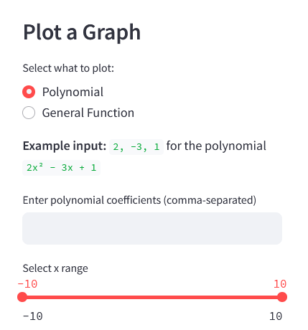
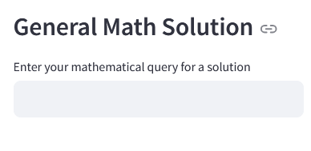
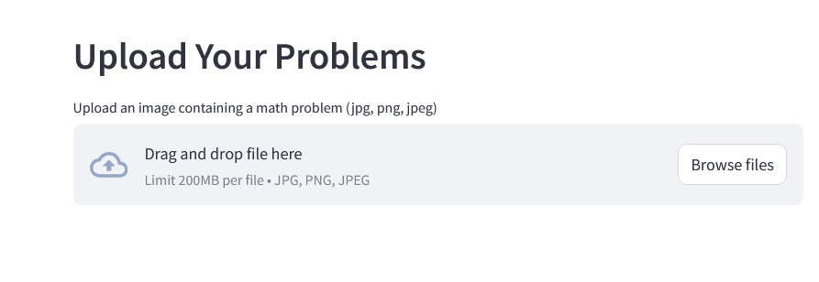
General Math Solution: It Responds to various math-related questions with detailed solutions
2. Plot a Graph: It has two selection for graph plotting:
Polynomial
General Functions: Trigonometric, linear
3. Upload Your Problems: It extracts text from images and detects math problems using Tesseract OCR. and solve if only related to maths problem.

Slide 17
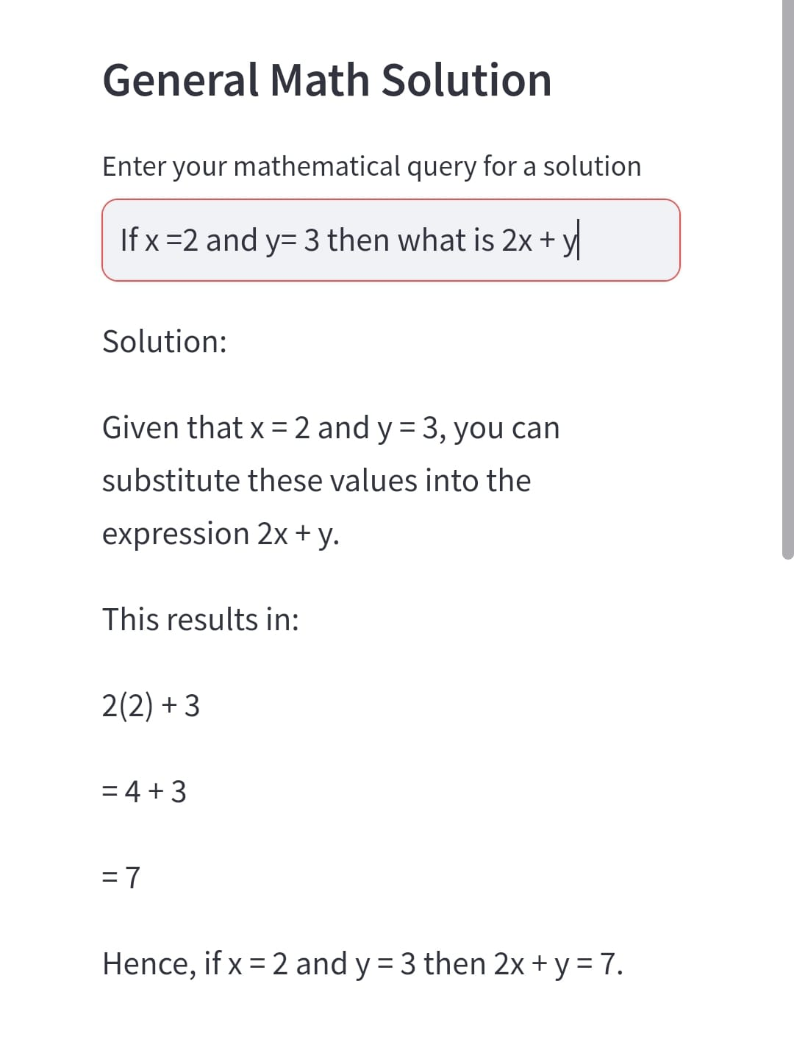
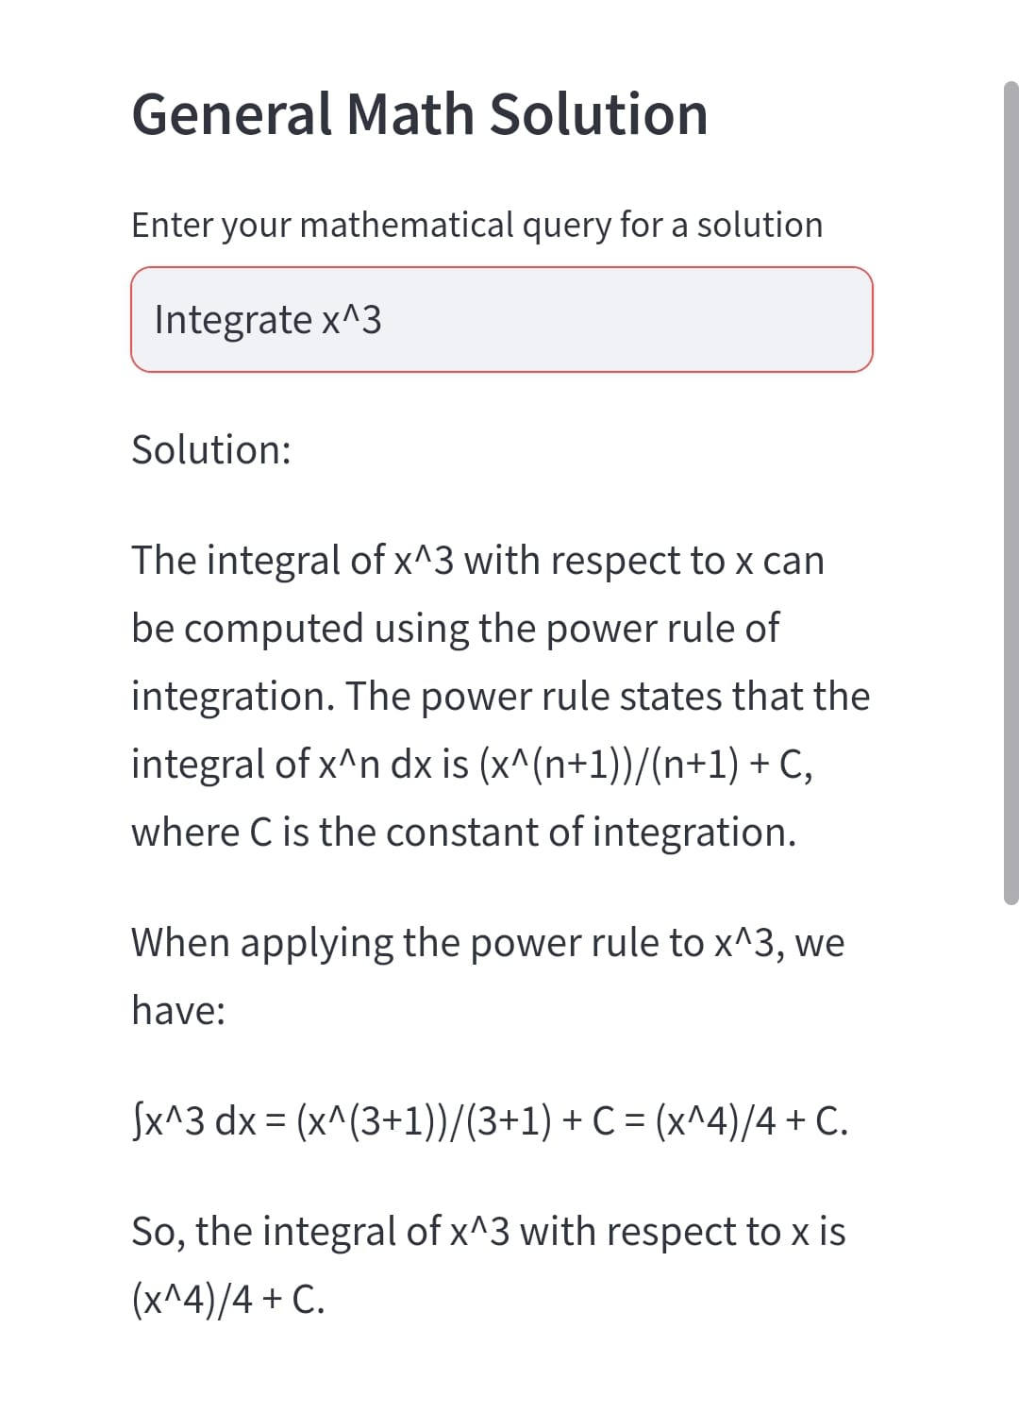
DEMO:GENERAL MATH SECTION

Slide 18
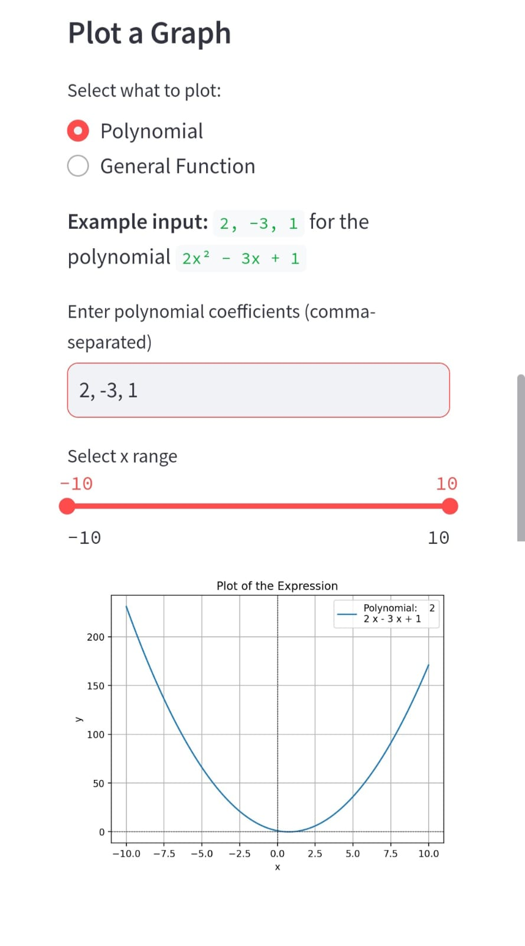
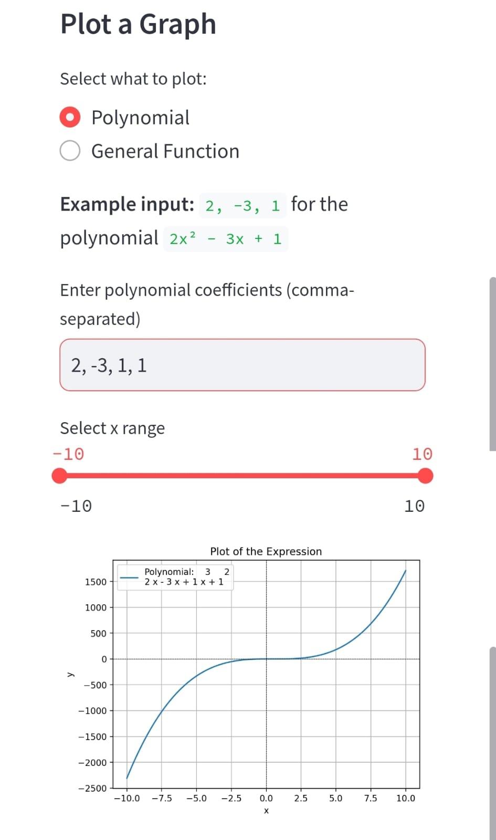
DEMO: PLOTTING GRAPH:
POLYNOMIAL

Slide 19
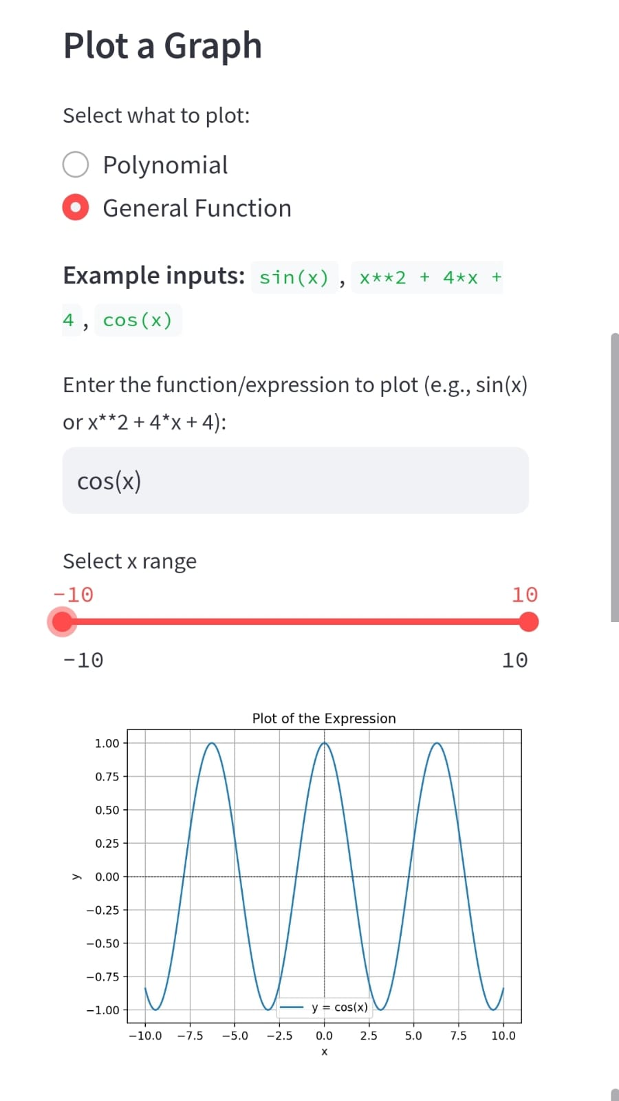
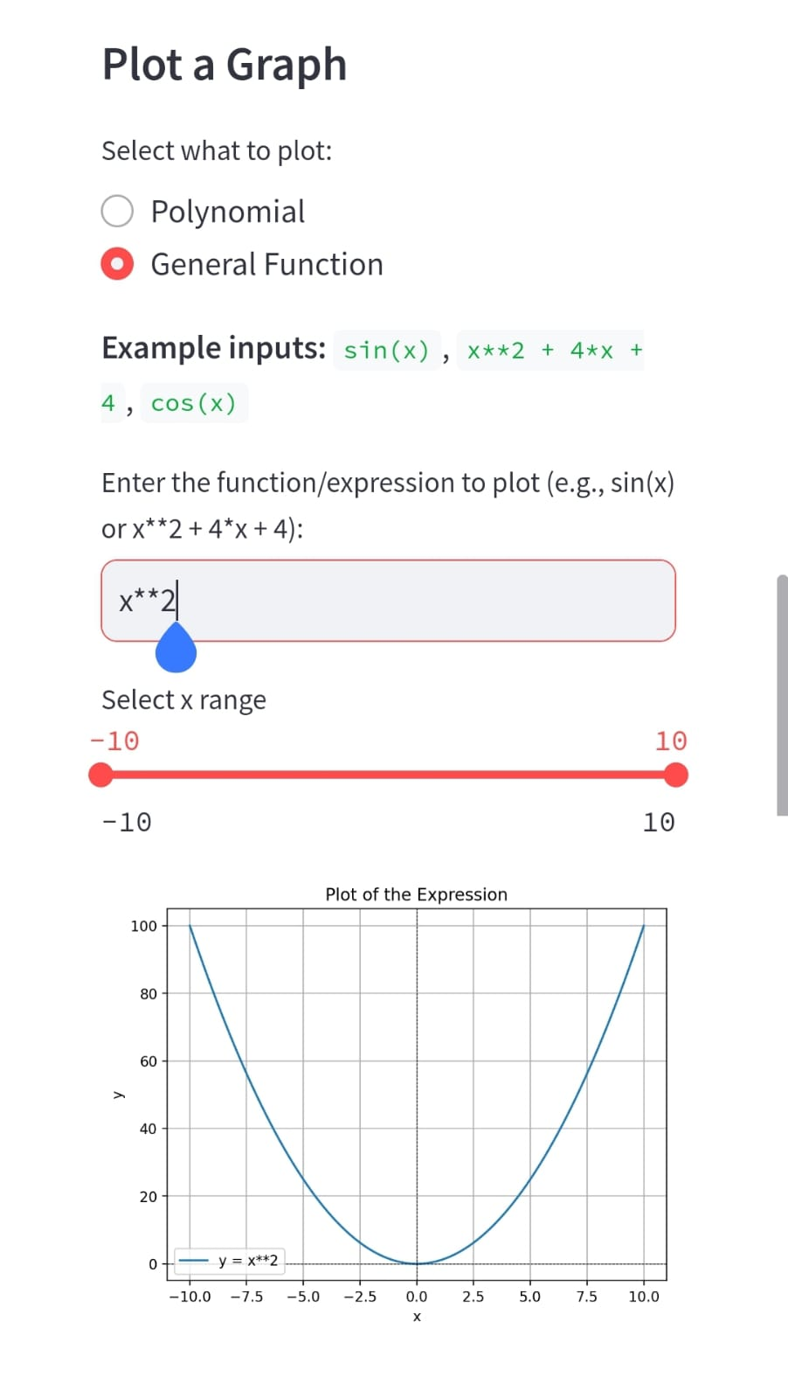
DEMO: PLOTTING GRAPH:
FUNCTIONS

Slide 20
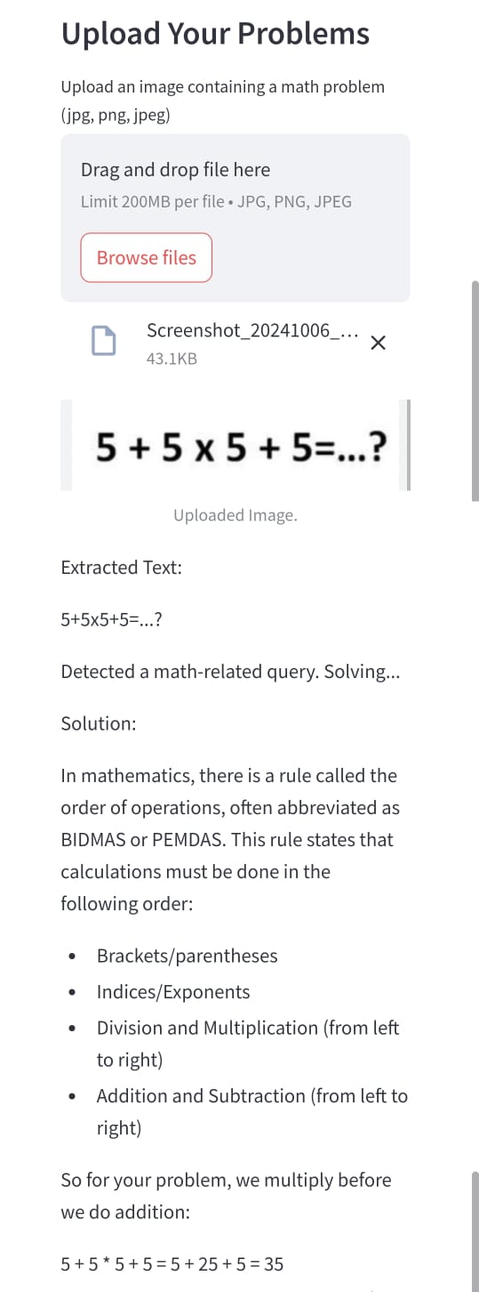
DEMO: OCR
FEATURES

Slide 21
THANK YOU: FUSEMACHINES

